Slide 1
Chapter 15 : Concurrency Control

Slide 2
Outline
Lock-Based Protocols
Timestamp-Based Protocols
Validation-Based Protocols
Multiple Granularity
Multiversion Schemes
Insert and Delete Operations
Concurrency in Index Structures

Slide 3
Lock-Based Protocols
Locks:
A lock is a mechanism to control concurrent access to a data item
Data items can be locked in two modes :
1. Exclusive (X) mode. Data item can be both read as well as
written. X-lock is requested using lock-X instruction.
2. Shared (S) mode. Data item can only be read. S-lock is
requested using lock-S instruction.
Lock requests are made to the concurrency-control manager by the transaction. Transaction can proceed with the operation only after the concurrency-control manager grants the lock to the transaction.
A transaction can unlock a data item using unlock instruction.

Slide 4

Lock-Based Protocols (Cont.)
Lock-compatibility matrix
A transaction may be granted a lock on an item if the requested lock is compatible with locks already held on the item by other transactions
Any number of transactions can hold shared locks on an item,
  But if any transaction holds an exclusive on the item no other transaction may hold any lock on the item.
If a lock cannot be granted, the requesting transaction is made to wait till all incompatible locks held by other transactions have been released. The lock is then granted.

Slide 5
Lock-Based Protocols (Cont.)
Note that shared mode is compatible with shared mode, but not with exclusive mode. At any time, several shared-mode locks can be held simultaneously (by different transactions) on a particular data item. A subsequent exclusive-mode lock request has to wait until the currently held shared-mode locks are released.
A transaction requests a shared lock on data item Q by executing the lock-S(Q) instruction. Similarly, a transaction requests an exclusive lock through the lock-X(Q) instruction. A transaction can unlock a data item Q by the unlock(Q) instruction.
Transaction Ti may unlock a data item that it had locked at some earlier point. Note that a transaction must hold a lock on a data item as long as it accesses that item. Moreover, for a transaction to unlock a data item immediately after its final access of that data item is not always desirable, since serializability may not be ensured.

Slide 6
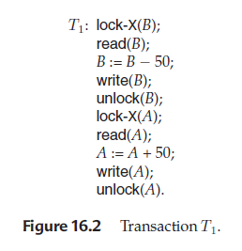
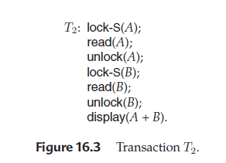
Lock-Based Protocols (Cont.)

Slide 7
Lock-Based Protocols (Cont.)
Let A and B be two accounts that are accessed by transactionsT1 and T2. Transaction T1 transfers $50 from account B to account A (Figure 16.2). Transaction T2 displays the total amount of money in accounts A and B—that is, the sum A + B (Figure 16.3).
Suppose that the values of accounts A and B are $100 and $200, respectively. If these two transactions are executed serially, either in the order T1, T2 or the order T2, T1, then transaction T2 will display the value $300.
If, however, these transactions are executed concurrently, then schedule 1, in Figure 16.4 is possible. In this case, transaction T2 displays $250, which is incorrect. The reason for this mistake is that the transaction T1 unlocked data item B too early, as a result of which T2 saw an inconsistent state.

Slide 8
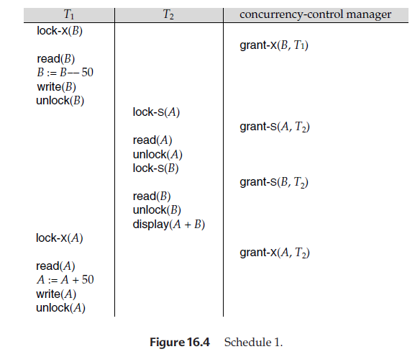
Lock-Based Protocols (Cont.)

Slide 9
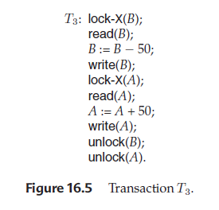
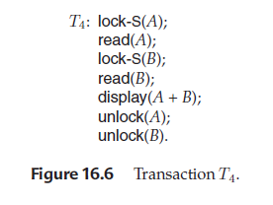
Lock-Based Protocols (Cont.)

Slide 10
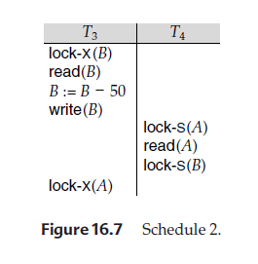
Lock-Based Protocols (Cont.)
Suppose now that unlocking is delayed to the end of the transaction. Transaction T3 corresponds to T1 with unlocking delayed (Figure 16.5). Transaction T4 corresponds to T2 with unlocking delayed (Figure 16.6).
You should verify that the sequence of reads and writes in schedule 1, which lead to an incorrect total of $250 being displayed, is no longer possible with T3 and T4.

Slide 11
Lock-Based Protocols (Cont.)
Consider the partial schedule of Figure 16.7 for T3 and T4. Since T3 is holding an exclusive-mode lock on B and T4 is requesting a shared-mode lock on B, T4 is waiting for T3 to unlock B. Similarly, since T4 is holding a shared-mode lock on A and T3 is requesting an exclusive-mode lock on A, T3 is waiting for T4 to unlock A. Thus, we have arrived at a state where neither of these transactions can ever proceed with its normal execution. This situation is called deadlock.
When deadlock occurs, the system must roll back one of the two transactions. Once a transaction has been rolled back, the data items that were locked by that transaction are unlocked. These data items are then available to the other transaction, which can continue with its execution

Slide 12
Lock-Based Protocols (Cont.)
We shall require that each transaction in the system follow a set of rules, called a locking protocol, indicating when a transaction may lock and unlock each of the data items. Locking protocols restrict the number of possible schedules. The set of all such schedules is a proper subset of all possible serializable schedules. We shall present several locking protocols that allow only conflict-serializable schedules.
We say that a schedule S is legal under a given locking protocol if S is a possible schedule for a set of transactions that follow the rules of the locking protocol.We say that a locking protocol ensures conflict serializability if and only if all legal schedules are conflict serializable; in other words, for all legal schedules the associated → relation is acyclic.

Slide 13
Lock-Based Protocols (Cont.)
Granting of Locks
When a transaction requests a lock on a data item in a particular mode, and no other transaction has a lock on the same data item in a conflicting mode, the lock can be granted. However, care must be taken to avoid the following scenario.
Suppose a transaction T2 has a shared-mode lock on a data item, and another transaction T1 requests an exclusive-mode lock on the data item. Clearly, T1 has to wait for T2 to release the shared-mode lock. Meanwhile, a transaction T3 may request a shared-mode lock on the same data item. The lock request is compatible with the lock granted to T2, so T3 may be granted the shared-mode lock. At this point T2 may release the lock, but still T1 has to wait for T3 to finish. The transaction T1 may never make progress, and is said to be starved.

Slide 14
Lock-Based Protocols (Cont.)
We can avoid starvation of transactions by granting locks in the following manner: When a transaction Ti requests a lock on a data item Q in a particular mode M, the concurrency-control manager grants the lock provided that
1. There is no other transaction holding a lock on Q in a mode that conflicts with M.
2. There is no other transaction that is waiting for a lock on Q, and that made its lock request before Ti.
Thus, a lock request will never get blocked by a lock request that is made later.

Slide 15
Lock-Based Protocols (Cont.)
The Two-Phase Locking Protocol
One protocol that ensures serializability is the two-phase locking protocol. This protocol requires that each transaction issue lock and unlock requests in two phases:
1. Growing phase: A transaction may obtain locks, but may not release any lock.
2. Shrinking phase: A transaction may release locks, but may not obtain any new locks.
Initially, a transaction is in the growing phase. The transaction acquires locks as needed. Once the transaction releases a lock, it enters the shrinking phase, and it can issue no more lock requests. For example, transactions T3 and T4 are two phase. On the other hand, transactions T1 and T2 are not two phase.
Two-phase locking does not ensure freedom from deadlock. Observe that transactions T3 and T4 are two phase, but, in schedule 2 (Figure 16.7), they are deadlocked.

Slide 16
Lock-Based Protocols (Cont.)
In addition to being serializable, schedules should be cascadeless. Cascading rollback may occur under two-phase locking. As an illustration, consider the partial schedule of Figure 16.8. Each transaction observes the two-phase locking protocol, but the failure of T5 after the read(A) step of T7 leads to cascading rollback of T6 and T7.
Cascading rollbacks can be avoided by a modification of two-phase locking called the strict two-phase locking protocol. This protocol requires not only that locking be two phase, but also that all exclusive-mode locks taken by a transaction be held until that transaction commits. This requirement ensures that any data written by an uncommitted transaction are locked in exclusive mode until the transaction commits, preventing any other transaction from reading the data.

Slide 17
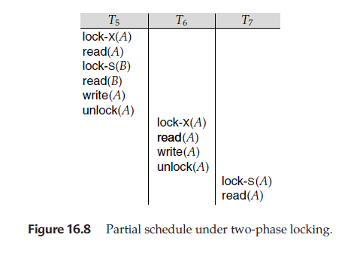
Lock-Based Protocols (Cont.)

Slide 18
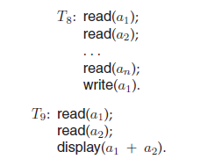
Lock-Based Protocols (Cont.)
Another variant of two-phase locking is the rigorous two-phase locking protocol, which requires that all locks be held until the transaction commits. With rigorous two-phase locking, transactions can be serialized in the order in which they commit. Most database systems implement either strict or rigorous two-phase locking.
Consider the following two transactions, for which we have shown only some of the significant read and write operations:

Slide 19
Lock-Based Protocols (Cont.)
If we employ the two-phase locking protocol, then T8 must lock a1 in exclusive mode. Therefore, any concurrent execution of both transactions amounts to a serial execution. Notice, however, that T8 needs an exclusive lock on a1 only at the end of its execution, when it writes a1. Thus, if T8 could initially lock a1 in shared mode, and then could later change the lock to exclusive mode, we could get more concurrency, since T8 and T9 could access a1 and a2 simultaneously. This observation leads us to a refinement of the basic two-phase locking protocol, in which lock conversions are allowed.
We denote conversion from shared to exclusive modes by upgrade, and from exclusive to shared by downgrade. Lock conversion cannot be allowed arbitrarily. Rather, upgrading can take place in only the growing phase, whereas downgrading can take place in only the shrinking phase.

Slide 20
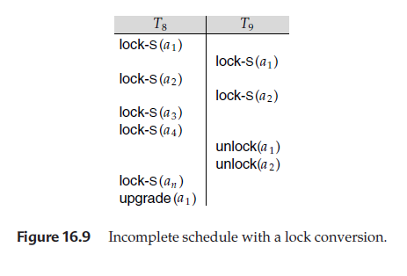
Lock-Based Protocols (Cont.)
Returning to our example, transactions T8 and T9 can run concurrently under the refined two-phase locking protocol, as shown in the incomplete schedule of Figure 16.9, where only some of the locking instructions are shown.

Slide 21
Lock-Based Protocols (Cont.)
Note that a transaction attempting to upgrade a lock on an item Q may be forced to wait. This enforced wait occurs if Q is currently locked by another transaction in shared mode.
Just like the basic two-phase locking protocol, two-phase locking with lock conversion generates only conflict-serializable schedules, and transactions can be serialized by their lock points. Further, if exclusive locks are held until the end of the transaction, the schedules are cascadeless.
Strict two-phase locking and rigorous two-phase locking (with lock conversions) are used extensively in commercial database systems.

Slide 22
Lock-Based Protocols (Cont.)
A simple but widely used scheme automatically generates the appropriate lock and unlock instructions for a transaction, on the basis of read and write requests from the transaction:
When a transaction Ti issues a read(Q) operation, the system issues a lock-S(Q) instruction followed by the read(Q) instruction.
When Ti issues a write(Q) operation, the system checks to see whether Ti already holds a shared lock on Q. If it does, then the system issues an upgrade(Q) instruction, followed by the write(Q) instruction. Otherwise, the system issues a lock-X(Q) instruction, followed by the write(Q) instruction.
All locks obtained by a transaction are unlocked after that transaction commits or aborts.

Slide 23
Lock-Based Protocols (Cont.)
Implementation of Locking:
A lock manager can be implemented as a separate process to which transactions send lock and unlock requests.
The lock manager replies to a lock request by sending a lock grant messages (or a message asking the transaction to roll back, in case of a deadlock).
The requesting transaction waits until its request is answered
The lock manager maintains a data-structure called a lock table to record granted locks and pending requests.
The lock table is usually implemented as an in-memory hash table indexed on the name of the data item being locked.
This algorithm guarantees freedom from starvation for lock requests, since a request can never be granted while a request received earlier is waiting to be granted.

Slide 24

Lock-Based Protocols (Cont.)
Dark blue rectangles indicate granted locks; light blue indicate waiting requests
Lock table also records the type of lock granted or requested
New request is added to the end of the queue of requests for the data item, and granted if it is compatible with all earlier locks
Unlock requests result in the request being deleted, and later requests are checked to see if they can now be granted
If transaction aborts, all waiting or granted requests of the transaction are deleted
  lock manager may keep a list of locks held by each transaction, to implement this efficiently
Fig. Lock table

Slide 25
Deadlock Handling
System is deadlocked if there is a set of transactions such that every transaction in the set is waiting for another transaction in the set.
The only remedy to this undesirable situation is for the system to invoke some drastic action, such as rolling back some of the transactions involved in the deadlock. Rollback of a transaction may be partial: That is, a transaction may be rolled back to the point where it obtained a lock whose release resolves the deadlock.
There are two principal methods for dealing with the deadlock problem. We can use a deadlock prevention protocol to ensure that the system will never enter a deadlock state. Alternatively, we can allow the system to enter a deadlock state, and then try to recover by using a deadlock detection and deadlock recovery scheme.
Prevention is commonly used if the probability that the system would enter a deadlock state is relatively high; otherwise, detection and recovery are more efficient.

Slide 26
Deadlock Handling (Cont.)
Deadlock Prevention:
There are two approaches to deadlock prevention. One approach is Advance locking of data items in random order or ordered way i.e., ascending or descending order. It ensures that no cyclic waits can occur by ordering the requests for locks, or requiring all locks to be acquired together.
The simplest scheme under the first approach requires that each transaction locks all its data items before it begins execution. Moreover, either all are locked in one step or none are locked. There are two main disadvantages to this protocol:
(1) it is often hard to predict, before the transaction begins, what data items need to be locked;
(2) data-item utilization may be very low, since many of the data items may be locked but unused for a long time.

Slide 27
Deadlock Handling (Cont.)
The second approach for preventing deadlocks is to use preemption and transaction rollbacks. In preemption, when a transaction T2 requests a lock that transaction T1 holds, the lock granted to T1 may be preempted by rolling back of T1, and granting of the lock to T2. To control the preemption, we assign a unique timestamp to each transaction. The system uses these timestamps only to decide whether a transaction should wait or roll back.
Two different deadlock prevention schemes using timestamps have been proposed:
1. The wait–die scheme is a non-preemptive technique. When transaction Ti requests a data item currently held by Tj , Ti is allowed to wait only if it has a timestamp smaller than that of Tj (that is, Ti is older than Tj ). Otherwise, Ti is rolled back (dies).

Slide 28
Deadlock Handling (Cont.)
For example, suppose that transactions T22, T23, and T24 have timestamps 5, 10, and 15, respectively. If T22 requests a data item held by T23, then T22 (wait) will wait. If T24 requests a data item held by T23, then T24 (dies) will be rolled back.
2. The wound–wait scheme is a preemptive technique. It is a counterpart to the wait–die scheme. When transaction Ti requests a data item currently held by Tj , Ti is allowed to wait only if it has a timestamp larger than that of Tj (that is, Ti is younger than Tj ). Otherwise, Tj is rolled back (Tj is wounded by Ti). Returning to our example, with transactions T22, T23, and T24, if T22 requests a data item held by T23, then the data item will be preempted from T23 (rollback-wounded), and T23 will be rolled back. If T24 requests a data item held by T23, then T24 will wait.
Whenever the system rolls back transactions, it is important to ensure that there is no starvation—that is, no transaction gets rolled back repeatedly and is never allowed to make progress.
Both the wound–wait and the wait–die schemes avoid starvation

Slide 29
Deadlock Handling (Cont.)
There are, however, significant differences in the way that the two schemes operate.
In the wait–die scheme, an older transaction must wait for a younger one to release its data item. Thus, the older the transaction gets, the more it tends to wait. By contrast, in the wound–wait scheme, an older transaction never waits for a younger transaction.
In the wait–die scheme, if a transaction Ti dies and is rolled back because it requested a data item held by transaction Tj, then Ti may reissue the same sequence of requests when it is restarted. If the data item is still held by Tj , then Ti will die again. Thus, Ti may die several times before acquiring the needed data item. Contrast this series of events with what happens in the wound–wait scheme. Transaction Ti is wounded and rolled back because Tj requested a data item that it holds. When Ti is restarted and requests the data item now being held by Tj , Ti waits. Thus, there may be fewer rollbacks in the wound–wait scheme.

Slide 30
Deadlock Handling (Cont.)
Timeout-Based Schemes:
  A transaction waits for a lock only for a specified amount of time. If the lock has not been granted within that time, the transaction is rolled back and restarted,
  Thus, deadlocks are not possible
  Simple to implement; but starvation is possible. Also difficult to determine good value of the timeout interval.

Slide 31
Deadlock Handling (Cont.)
Deadlock Detection:
Deadlocks can be described precisely in terms of a directed graph called a wait-for graph. This graph consists of a pair G = (V, E), where V is a set of vertices and E is a set of edges. The set of vertices consists of all the transactions in the system. Each element in the set E of edges is an ordered pair Ti → Tj.
If Ti → Tj is in E, then there is a directed edge from transaction Ti to Tj , implying that transaction Ti is waiting for transaction Tj to release a data item that it needs.
When transaction Ti requests a data item currently being held by transaction Tj , then the edge Ti → Tj is inserted in the wait-for graph. A deadlock exists in the system if and only if the wait-for graph contains a cycle.
To detect deadlocks, the system needs to maintain the wait-for graph, and periodically to invoke an algorithm that searches for a cycle in the graph.

Slide 32
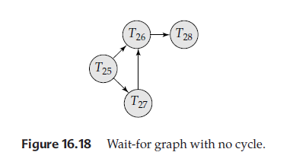
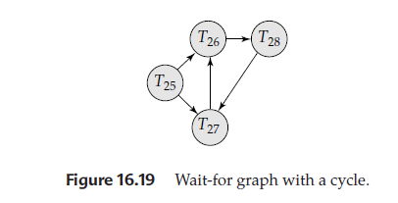
Deadlock Handling (Cont.)
Since the graph has no cycle, the system is not in a deadlock state.
This time, the graph contains the cycle T26 → T28 →T27 →T26
implying that transactions T26, T27, and T28 are all deadlocked.

Slide 33
Deadlock Handling (Cont.)
Deadlock Recovery:
When a detection algorithm determines that a deadlock exists, the system must recover from the deadlock. The most common solution is to roll back one or more transactions to break the deadlock. Three actions need to be taken:
1. Selection of a victim. Given a set of deadlocked transactions, we must determine which transaction (or transactions) to roll back to break the deadlock. We should roll back those transactions that will incur the minimum cost.
2. Rollback. Once we have decided that a particular transaction must be rolled back, we must determine how far this transaction should be rolled back. The simplest solution is a total rollback: Abort the transaction and then restart it. However, it is more effective to roll back the transaction only as far as necessary to break the deadlock. Such partial rollback requires the system to maintain additional information about the state of all the running transactions.

Slide 34
Deadlock Handling (Cont.)
3. Starvation. In a system where the selection of victims is based primarily on cost factors, it may happen that the same transaction is always picked as a victim. As a result, this transaction never completes its designated task, thus there is starvation. We must ensure that transaction can be picked as a victim only a (small) finite number of times. The most common solution is to include the number of rollbacks in the cost factor.

Slide 35
Multiple Granularity
In the concurrency-control schemes described thus far, we have used each individual data item as the unit on which synchronization is performed.
There are circumstances, however, where it would be advantageous to group several data items, and to treat them as one individual synchronization unit.
For example, if a transaction Ti needs to access the entire database, and a locking protocol is used, then Ti must lock each data item in the database. Clearly, executing these locks is time consuming.
It would be better if Ti could issue a single lock request to lock the entire database. On the other hand, if transaction Tj needs to access only a few data items, it should not be required to lock the entire database, since otherwise concurrency is lost.
What is needed is a mechanism to allow the system to define multiple levels of granularity.
We can make one by allowing data items to be of various sizes and defining a hierarchy of data granularities, where the small granularities are nested within larger ones. Such a hierarchy can be represented graphically as a tree.

Slide 36

Multiple Granularity (Cont.)
Fig. Granularity Hierarchy
The levels, starting from the coarsest (top) level are
  DataBase (DB)
  Area (A₁, A₂)
  File (F_{a}, F_{b}, F_{c})
  Record (r_{a1}, r_{a2}, …., r_{an}, r_{b1}, …., r_{bk}, r_{c1}, …., r_{cm})

Slide 37
Multiple Granularity (Cont.)
As an illustration, consider the above Fig., which consists of four levels of nodes. The highest level represents the entire database. Below it are nodes of type area; the database consists of exactly these areas.
Each area in turn has nodes of type file as its children. Each area contains exactly those files that are its child nodes. No file is in more than one area. Finally, each file has nodes of type record. As before, the file consists of exactly those records that are its child nodes, and no record can be present in more than one file.
Each node in the tree can be locked individually. As we did in the two-phase locking protocol, we shall use shared and exclusive lock modes. When a transaction locks a node, in either shared or exclusive mode, the transaction also has implicitly locked all the descendants of that node in the same lock mode.
For example, if transaction Ti gets an explicit lock on file Fc of Fig., in exclusive mode, then it has an implicit lock in exclusive mode all the records belonging to that file. It does not need to lock the individual records of Fc explicitly.

Slide 38
Multiple Granularity (Cont.)
Suppose now that transaction T_{k} wishes to lock the entire database. To do so, it simply must lock the root of the hierarchy.
Note, however, that T_{k} should not succeed in locking the root node, since Ti is currently holding a lock on part of the tree (specifically, on file Fc).
But how does the system determine if the root node can be locked? One possibility is for it to search the entire tree. This solution, however, defeats the whole purpose of the multiple-granularity locking scheme.
A more efficient way to gain this knowledge is to introduce a new class of lock modes, called intention lock modes.
If a node is locked in an intention mode, explicit locking is being done at a lower level of the tree (that is, at a finer granularity). Intention locks are put on all the ancestors of a node before that node is locked explicitly.
Thus, a transaction does not need to search the entire tree to determine whether it can lock a node successfully.

Slide 39
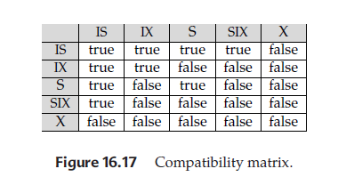
Multiple Granularity (Cont.)
There is an intention mode associated with shared mode, and there is one with exclusive mode. If a node is locked in intention-shared (IS) mode, explicit locking is being done at a lower level of the tree, but with only shared-mode locks. Similarly, if a node is locked in intention-exclusive (IX) mode, then explicit locking is being done at a lower level, with exclusive-mode or shared-mode locks.
Finally, if a node is locked in shared and intention-exclusive (SIX) mode, the subtree rooted by that node is locked explicitly in shared mode, and that explicit locking is being done at a lower level with exclusive-mode locks.
The compatibility function for these lock modes is in Figure 16.17.

Slide 40
Multiple Granularity (Cont.)
The multiple-granularity locking protocol, which ensures serializability, is this: Each transaction Ti can lock a node Q by following these rules:
1. It must observe the lock-compatibility function of Figure 16.17.
2. It must lock the root of the tree first, and can lock it in any mode.
3. It can lock a node Q in S or IS mode only if it currently has the parent of Q locked in either IX or IS mode.
4. It can lock a node Q in X, SIX, or IX mode only if it currently has the parent of Q locked in either IX or SIX mode.
5. It can lock a node only if it has not previously unlocked any node (that is, Ti is two phase).
6. It can unlock a node Q only if it currently has none of the children of Q locked.
Observe that the multiple-granularity protocol requires that locks be acquired in top-down (root-to-leaf) order, whereas locks must be released in bottom-up (leaf-to-root) order.

Slide 41
Multiple Granularity (Cont.)
As an illustration of the protocol, consider the tree of Figure 16.16 and these transactions:
• Suppose that transaction T18 reads record ra2 in file Fa. Then, T18 needs to lock the database, area A1, and Fa in IS mode (and in that order), and finally to lock ra2 in S mode.
• Suppose that transaction T19 modifies record ra9 in file Fa. Then, T19 needs to lock the database, area A1, and file Fa in IX mode, and finally to lock ra9 in X mode.
• Suppose that transaction T20 reads all the records in file Fa. Then, T20 needs to lock the database and area A1 (in that order) in IS mode, and finally to lock Fa in S mode.
• Suppose that transaction T21 reads the entire database. It can do so after locking the database in S mode.
We note that transactions T18, T20, and T21 can access the database concurrently. Transaction T19 can execute concurrently with T18, but not with either T20 or T21.

Slide 42
Multiple Granularity (Cont.)
This protocol enhances concurrency and reduces lock overhead. It is particularly useful in applications that include a mix of
• Short transactions that access only a few data items
• Long transactions that produce reports from an entire file or set of files
Deadlock is possible in the protocol that we have, as it is in the two-phase locking protocol. There are techniques to reduce deadlock frequency in the multiple-granularity protocol, and also to eliminate deadlock entirely.

Slide 43
Timestamp-Based Protocols
Another method for determining the serializability order is to select an ordering among transactions in advance. The most common method for doing so is to use a timestamp-ordering scheme.
Timestamps
If a transaction Ti has been assigned timestamp TS(Ti), and a new transaction Tj enters the system, then TS(Ti) < TS(Tj ). There are two simple methods for implementing this scheme:
1. Use the value of the system clock as the timestamp; that is, a transaction’s timestamp is equal to the value of the clock when the transaction enters the system.
2. Use a logical counter that is incremented after a new timestamp has been assigned; that is, a transaction’s timestamp is equal to the value of the counter when the transaction enters the system.
The timestamps of the transactions determine the serializability order. Thus, if TS(Ti) < TS(Tj ), then the system must ensure that the produced schedule is equivalent to a serial schedule in which transaction Ti appears before transaction Tj .

Slide 44
Timestamp-Based Protocols (Cont.)
To implement this scheme, we associate with each data item Q two timestamp values:
W-timestamp(Q) denotes the largest timestamp of any transaction that executed write(Q) successfully.
R-timestamp(Q) denotes the largest timestamp of any transaction that executed read(Q) successfully.
These timestamps are updated whenever a new read(Q) or write(Q) instruction is executed.

Slide 45
Timestamp-Based Protocols (Cont.)
The Timestamp-Ordering Protocol:
The timestamp-ordering protocol ensures that any conflicting read and write operations are executed in timestamp order. This protocol operates as follows:
1. Suppose that transaction Ti issues read(Q).
a. If TS(Ti) < W-timestamp(Q), then Ti needs to read a value of Q that was already overwritten. Hence, the read operation is rejected, and Ti is rolled back.
b. If TS(Ti) ≥ W-timestamp(Q), then the read operation is executed, and sets R-timestamp(Q) as TS(Ti).
2. Suppose that transaction Ti issues write(Q).
a. If TS(Ti) < R-timestamp(Q), then the value of Q that Ti is producing was needed previously, and the system assumed that the value would never be produced. Hence, the system rejects the write operation and rolls Ti back.

Slide 46
Timestamp-Based Protocols (Cont.)
b. If TS(Ti) < W-timestamp(Q), then Ti is attempting to write an obsolete value of Q. Hence, the system rejects this write operation and rolls Ti back.
c. Otherwise, the system executes the write operation and sets W-timestamp(Q) as TS(Ti).
The timestamp-ordering protocol ensures conflict serializability. This is because conflicting operations are processed in timestamp order. The protocol ensures freedom from deadlock, since no transaction ever waits.
However, there is a possibility of starvation of long transactions if a sequence of conflicting short transactions causes repeated restarting of the long transaction. If a transaction is found to be getting restarted repeatedly, conflicting transactions need to be temporarily blocked to enable the transaction to finish.

Slide 47
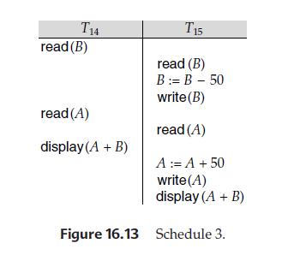
Timestamp-Based Protocols (Cont.)
Thus, in schedule 3 of Figure 16.13, TS(T14) < TS(T15), and the schedule is possible under the timestamp protocol.

Slide 48
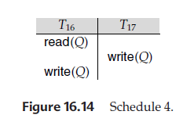
Timestamp-Based Protocols (Cont.)
Thomas Write rule:
We now present a modification to the timestamp-ordering protocol that allows greater potential concurrency than timestamp-ordering protocol.
Let us consider schedule 4 of Figure 16.14, and apply the timestamp-ordering protocol. Since T16 starts before T17, we shall assume that TS(T16) < TS(T17). The read(Q) operation of T16 succeeds, as does the write(Q) operation of T17.When T16 attempts its write(Q) operation, we find that TS(T16) < W-timestamp(Q), since W-timestamp(Q) = TS(T17). Thus, the write(Q) by T16 is rejected and transaction T16 must be rolled back.

Slide 49
Timestamp-Based Protocols (Cont.)
Although the rollback of T16 is required by the timestamp-ordering protocol, it is unnecessary. Since T17 has already written Q, the value that T16 is attempting to write is one that will never need to be read.
This observation leads to a modified version of the timestamp-ordering protocol in which obsolete write operations can be ignored under certain circumstances. The protocol rules for read operations remain unchanged. The protocol rules for write operations, however, are slightly different from the timestamp-ordering protocol
The modification to the timestamp-ordering protocol, called Thomas’ write rule, is this: Suppose that transaction Ti issues write(Q).
1. If TS(Ti) < R-timestamp(Q), then the value of Q that Ti is producing was previously needed, and it had been assumed that the value would never be produced. Hence, the system rejects the write operation and rolls Ti back.
2. If TS(Ti) < W-timestamp(Q), then Ti is attempting to write an obsolete value of Q. Hence, this write operation can be ignored.
3. Otherwise, the system executes the write operation and sets W-timestamp(Q) as TS(Ti).

Slide 50
Timestamp-Based Protocols (Cont.)
Thomas’ write rule makes use of view serializability by, in effect, deleting obsolete write operations from the transactions that issue them.
For example, schedule 4 of Figure 16.14 is not conflict serializable and, thus, is not possible under any of two-phase locking, the tree protocol, or the timestamp-ordering protocol. Under Thomas’ write rule, the write(Q) operation of T16 would be ignored. The result is a schedule that is view equivalent to the serial schedule <T16, T17>.

Slide 51
Validation Based Protocols
We assume that each transaction Ti executes in two or three different phases in its lifetime, depending on whether it is a read-only or an update transaction. The phases are, in order,
1. Read phase. During this phase, the system executes transaction Ti. It reads the values of the various data items and stores them in variables local to Ti. It performs all write operations on temporary local variables, without updates of the actual database.
2. Validation phase. Transaction Ti performs a validation test to determine whether it can copy to the database the temporary local variables that hold the results of write operations without causing a violation of serializability.
3. Write phase. If transaction Ti succeeds in validation (step 2), then the system applies the actual updates to the database. Otherwise, the system rolls back Ti.
Each transaction must go through the three phases in the order shown.

Slide 52
Validation Based Protocols (Cont.)
To perform the validation test, we need to know when the various phases of transactions Ti took place. We shall, therefore, associate three different timestamps with transaction Ti:
1. Start(Ti), the time when Ti started its execution.
2. Validation(Ti), the time when Ti finished its read phase and started its validation phase.
3. Finish(Ti), the time when Ti finished its write phase.
We determine the serializability order by the timestamp-ordering technique, using the value of the timestamp Validation(Ti). The reason we have chosen Validation(Ti), rather than Start(Ti), as the timestamp of transaction Ti is that we can expect faster response time provided that conflict rates among transactions are indeed low.
The validation test for transaction Tj requires that, for all transactions Ti with TS(Ti) < TS(Tj ), one of the following two conditions must hold:
1. Finish(Ti) < Start(Tj ). Since Ti completes its execution before Tj started, the serializability order is indeed maintained.

Slide 53
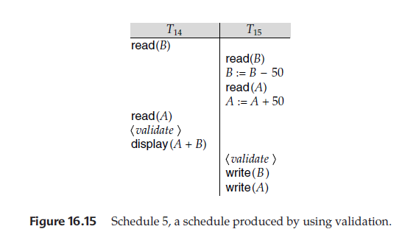
Validation Based Protocols (Cont.)
2. The set of data items written by Ti does not intersect with the set of data items read by Tj, and Ti completes its write phase before Tj starts its validation phase (Start(Tj ) < Finish(Ti) < Validation(Tj )). This condition ensures that the writes of Ti and Tj do not overlap. Since the writes of Ti do not affect the read of Tj , and since Tj cannot affect the read of Ti, the serializability order is indeed maintained.

Slide 54
Validation Based Protocols (Cont.)
As an illustration, consider again transactions T14 and T15. Suppose that TS(T14)< TS(T15). Then, the validation phase succeeds in the schedule 5 in Figure 16.15. Note that the writes to the actual variables are performed only after the validation phase of T15. Thus, T14 reads the old values of B and A, and this schedule is serializable.
The validation scheme automatically guards against cascading rollbacks, since the actual writes take place only after the transaction issuing the write has committed.
However, there is a possibility of starvation of long transactions, due to a sequence of conflicting short transactions that cause repeated restarts of the long transaction. To avoid starvation, conflicting transactions must be temporarily blocked, to enable the long transaction to finish.
This validation scheme is called the optimistic concurrency control scheme since transactions execute optimistically, assuming they will be able to finish execution and validate at the end.

Slide 55
Multiversion Schemes
Multiversion schemes keep old versions of data item to increase concurrency.
  Multiversion Timestamp Ordering
  Multiversion Two-Phase Locking
Each successful write results in the creation of a new version of the data item written.
Use timestamps to label versions.
When a read(Q) operation is issued, select an appropriate version of Q based on the timestamp of the transaction, and return the value of the selected version.
reads never have to wait as an appropriate version is returned immediately.

Slide 56
Multiversion Timestamp Ordering
Each data item Q has a sequence of versions <Q₁, Q₂,...., Q_{m}>. Each version Q_{k} contains three data fields:
  Content -- the value of version Q_{k}.
  W-timestamp(Q_{k}) -- timestamp of the transaction that created (wrote) version Q_{k}
  R-timestamp(Q_{k}) -- largest timestamp of a transaction that successfully read version Q_{k}
When a transaction T_{i} creates a new version Q_{k} of Q, Q_{k}'s W-timestamp and R-timestamp are initialized to TS(T_{i}).
R-timestamp of Q_{k} is updated whenever a transaction T_{j} reads Q_{k}, and TS(T_{j}) > R-timestamp(Q_{k}).

Slide 57
Multiversion Timestamp Ordering (Cont)
Suppose that transaction T_{i} issues a read(Q) or write(Q) operation. Let Q_{k} denote the version of Q whose write timestamp is the largest write timestamp less than or equal to TS(T_{i}).
  If transaction T_{i} issues a read(Q), then the value returned is the content of version Q_{k}.
  If transaction T_{i} issues a write(Q)
    if TS(T_{i}) < R-timestamp(Q_{k}), then transaction T_{i} is rolled back.
    if TS(T_{i}) = W-timestamp(Q_{k}), the contents of Q_{k} are overwritten
    else a new version of Q is created.
Observe that
  Reads always succeed
  A write by T_{i} is rejected if some other transaction T_{j} that (in the serialization order defined by the timestamp values) should read
  T_{i}'s write, has already read a version created by a transaction older than T_{i}.
Protocol guarantees serializability

Slide 58
Multiversion Two-Phase Locking
Differentiates between read-only transactions and update transactions
Update transactions acquire read and write locks, and hold all locks up to the end of the transaction. That is, update transactions follow rigorous two-phase locking.
  Each successful write results in the creation of a new version of the data item written.
  Each version of a data item has a single timestamp whose value is obtained from a counter ts-counter that is incremented during commit processing.
Read-only transactions are assigned a timestamp by reading the current value of ts-counter before they start execution; they follow the multiversion timestamp-ordering protocol for performing reads.

Slide 59
Multiversion Two-Phase Locking (Cont.)
When an update transaction wants to read a data item:
  it obtains a shared lock on it, and reads the latest version.
When it wants to write an item
  it obtains X lock on; it then creates a new version of the item and sets this version's timestamp to ∞.
When update transaction T_{i} completes, commit processing occurs:
  T_{i} sets timestamp on the versions it has created to ts-counter + 1
  T_{i} increments ts-counter by 1
Read-only transactions that start after T_{i} increments ts-counter will see the values updated by T_{i}.
Read-only transactions that start before T_{i} increments the
ts-counter will see the value before the updates by T_{i}.
Only serializable schedules are produced.

Slide 60
Insert and Delete Operations
If two-phase locking is used :
  A delete operation may be performed only if the transaction deleting the tuple has an exclusive lock on the tuple to be deleted.
  A transaction that inserts a new tuple into the database is given an X-mode lock on the tuple
Insertions and deletions can lead to the phantom phenomenon.
  A transaction that scans a relation
    (e.g., find sum of balances of all accounts in Perryridge)
    and a transaction that inserts a tuple in the relation
    (e.g., insert a new account at Perryridge)
    (conceptually) conflict in spite of not accessing any tuple in common.
  If only tuple locks are used, non-serializable schedules can result
    E.g. the scan transaction does not see the new account, but reads some other tuple written by the update transaction

Slide 61
Insert and Delete Operations (Cont.)
The transaction scanning the relation is reading information that indicates what tuples the relation contains, while a transaction inserting a tuple updates the same information.
  The conflict should be detected, e.g. by locking the information.
One solution:
  Associate a data item with the relation, to represent the information about what tuples the relation contains.
  Transactions scanning the relation acquire a shared lock in the data item,
  Transactions inserting or deleting a tuple acquire an exclusive lock on the data item. (Note: locks on the data item do not conflict with locks on individual tuples.)
Above protocol provides very low concurrency for insertions/deletions.
Index locking protocols provide higher concurrency while
preventing the phantom phenomenon, by requiring locks
on certain index buckets.

